Slide 1
Jean Squires – Senior Principal Account Manager
Jean has worked in the travel industry for over 25 years, starting in the airline industry before moving to Hogg Robinson Travel where she worked in a number of disciplines before becoming Head of Hotel Consulting managing the sourcing, negotiation and delivery of numerous hotel programmes for clients as diverse as Ericsson, Astra Zeneca, MARS, Shell, KPMG, HSBC and Rolls Royce plc.
She also worked on Travel Policy development and projects associated with sourcing for other travel categories including work on the fundamentals of Strategic Meetings Management.
Having joined Lanyon in 2011 her specialist skills and experience in this category continue to help clients achieve process improvements and overall cost savings through effective use of appropriate tools and services, strong negotiation and focused compliance management.
Jean has written a number of White Papers and delivered Webinars on strategic sourcing for both Transient and Meetings programmes.
Her current client portfolio includes Teva Pharmaceuticals, BP, British Airways, UBS and AIG.
Jean is a graduate of Durham University and has an MBA from Oxford Brookes University.
She is based in Worcestershire, UK

Slide 2
Lanyon and Cvent Merger
Vista Equity Partners – owners of Lanyon since 2013 – acquired Cvent in November 2016 and has now merged the 2 companies under the name of Cvent to form the largest single provider of technology solutions for Total Hospitality Spend Management in the world.
Company Founded in 1984 (Lanyon) / 1999 (Cvent)
Current FTE - 2,500
Head Quartered in USA
Regional offices in USA / UK / India / Singapore / Australia

Slide 3
Global Footprint
Our software is deployed by customers globally
We support our customers – both corporate and supply-side – from offices around the world – North America, UK, India, Singapore, Australia

Slide 4
ONE PLATFORM TO DELIVER TOTAL HOSPITALITY SPEND MANAGEMENT
The FULL cvent product suite
VENUE SOURCING
EVENT MANAGEMENT
MEETINGS MANAGEMENT
CVENT PASSKEY
REGONLINE by CVENT
CVENT CONFERENCE
CVENT BUSINESS TRANSIENT (formerly Lanyon)
ON SITE SOLUTIONS
CVENT CROWDCOMPASS
INQUISIUM by CVENT

Slide 5
Cvent Business Transient – Rate Sourcing and Compliance Management Suite
The Cvent Transient product suite comprises the following tools:
Transient Rate Sourcing (RFP Tool)
The tool provides full visibility and management of the entire sourcing process from bid set up, through bid list creation, RFP distribution, email failure reporting, bid evaluation and scoring, total cost of stay analysis, rate negotiation, rate acceptance, and extensive on-demand reporting
On-line Hotel Directory (OHD)
This tool is much more than a simple hotel directory. The portal can be configured extensively to contain information relevant and useful to the end user. It is easy to use and effective in providing users with the information they need about the agreed rates, what is included and any restrictions as well as ancillary information about each property. The information is pulled directly from the RFP and refreshes nightly.
Marketplace Intelligence Rate Benchmarking (MI)
MI is our on-line business intelligence dashboard that displays real-time market and pricing analysis of proposed and/or negotiated corporate rates plus included amenities from solicited hotels. Rate benchmarking gives the opportunity to ensure that all supplier proposals are competitive. This reporting provides objective evidence of negotiated rate and amenity values to make it possible accurately to assess potential savings attributable to your negotiated transient programme. Reports can be run at any time and, as the database refreshes regularly, will reflect the most current data available.

Slide 6
Cvent Business Transient – Rate Sourcing and Compliance Management Suite
GDS Rate Audit
This ensures that all negotiated pricing has been completely and correctly loaded by all hotels in every applicable Global Distribution System (GDS). The solution harnesses web service links with Sabre, Abacus, Galileo, Apollo, Worldspan and Amadeus to perform comprehensive automated checks. The solution checks up to five dates in four seasons for every property and reports on the nature of any failure. The tool also reports on prevailing BAR (Best Available Rates). Integrated failure notification can be used to send batch communications to properties that fail the audit and to provide detailed instructions on how to rectify the failure.
GDS Rate Availability Reporting
Property Revenue Managers are responsible for maximising the revenue potential for each property. This frequently means that individual properties may decide to withdraw negotiated inventory or submit higher than agreed negotiated pricing without the client’s knowledge or agreement. Rate Availability reporting runs throughout the life of the hotel programme checking the GDS on a monthly basis to see what rates are actually being returned for potential bookings for that client over the forthcoming 3-4 weeks (usually the time frame when most hotel bookings are made). Rate Availability reporting ensures that preferred properties are offering the negotiated terms in the GDS at the point of sale (both through an agency and / or via self-booking tool (SBT)). Detailed reports identify which properties have failed to offer negotiated rates and highlight what rate is actually being offered. Integrated failure notification can then be used to communicate with properties and provide detailed instructions on how to rectify the failure.

Slide 7
Cvent Business Transient – Rate Sourcing and Compliance Management Suite
Rate Parity Reporting
Rate Parity reporting complements Rate Availability reporting by comparing negotiated rates in preferred properties against public pricing (excluding Advance Purchase, Non-Refundable Rates) that is being offered directly at online travel agency and/or hotel supplier websites. Rate Parity can check up to 350 of the world’s most popular travel sites. Detailed reporting identifies the date and site that has lower pricing for every preferred supplier. This facility maintains the validity of the sourcing process by ensuring that negotiated rates have integrity when compared to popular online travel and supplier websites. Numerous online providers such as Google and Expedia provide travellers with instant access to public pricing and compare them to your negotiated rates. By checking in advance of travel, we can provide the necessary facts and objective evidence to preferred suppliers to encourage them to reduce contracted rates to maintain competitiveness. Clients using this solution have identified that approximately 25% of their programme savings is at risk due to lower unrestricted rates that are available online.
GDS Squatter (Reverse) Audit
Reverse Audit enables customers to run an audit against their preferred list of hotels to determine if any hotels have loaded negotiated or consortia rates that have not been accepted into the preferred programme. These properties are also referred to as “squatters”

Slide 8
Transient Rate Sourcing Process
Setup RFP
Create Hotel List
Send RFP
Review Bids
Negotiate & Accept
Reports
Easy-to-Use
Streamlined and Consistent Approach
Accurate Data
Informed Decision Making
Reduce Rates by 2-5%
Reduce Time by 50%
8

Slide 9
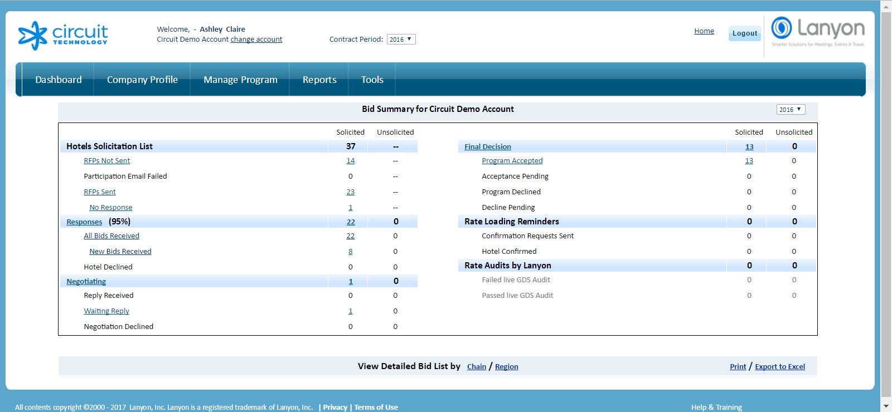
Dashboard

Slide 10
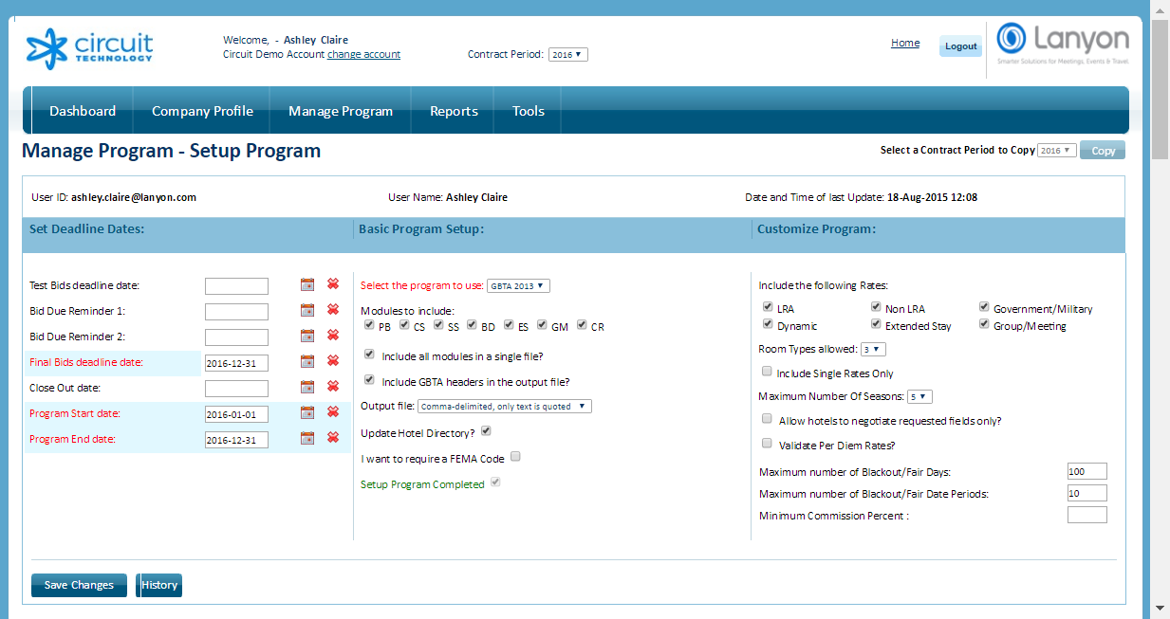
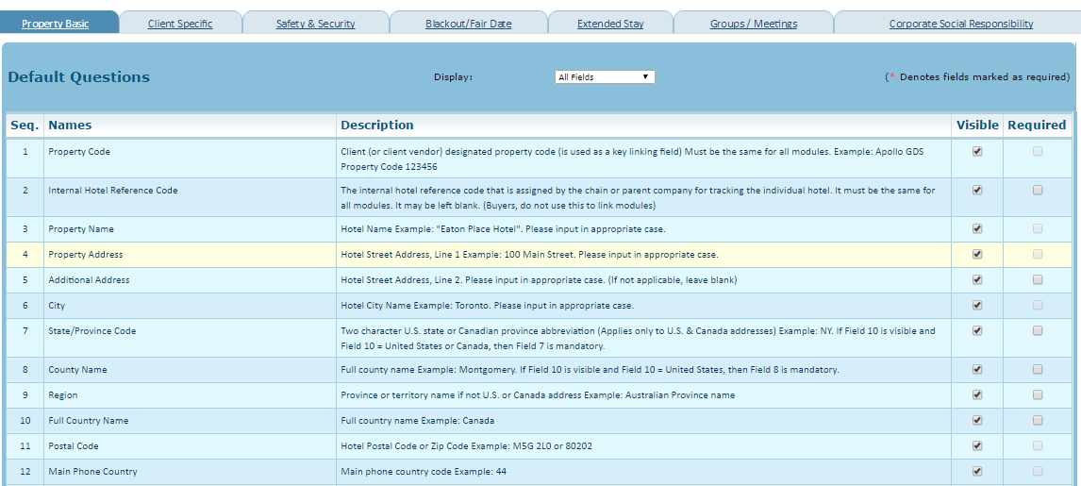
Setup RFP
Setup RFP

Slide 11
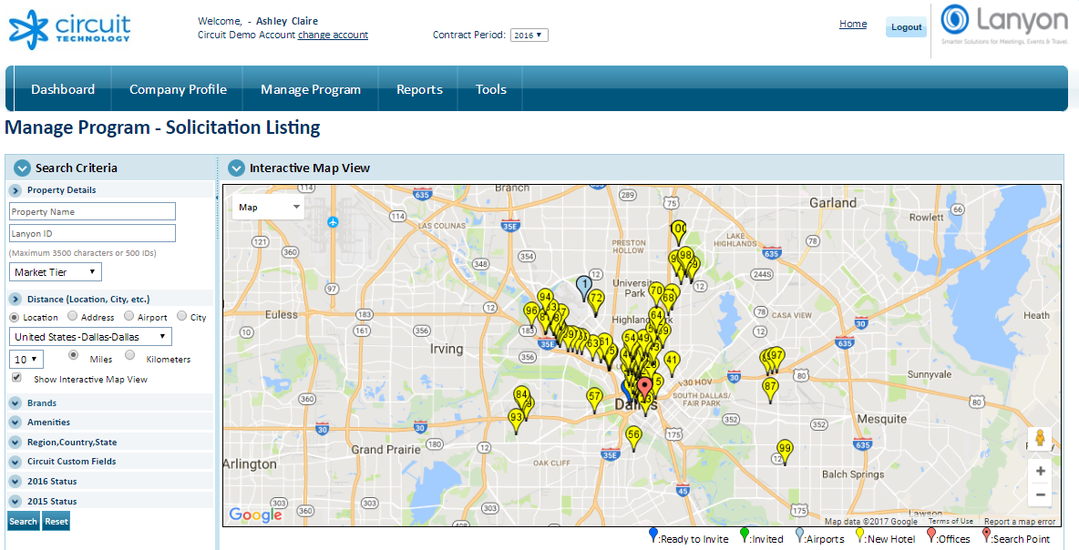
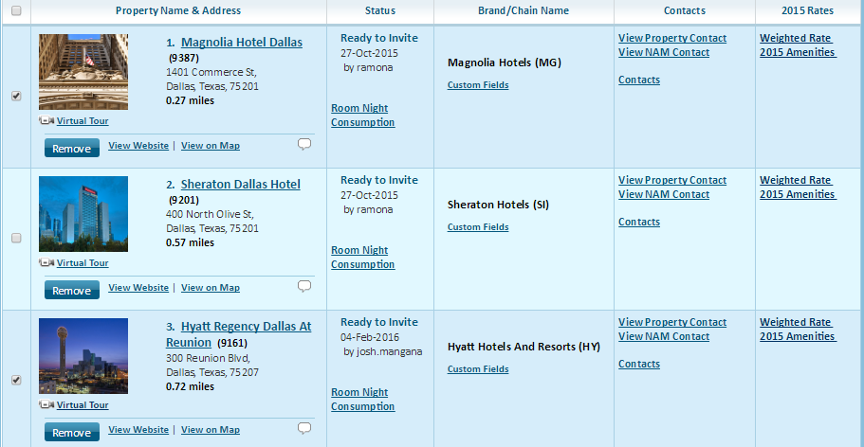
Create Hotel List and Send RFP
Create Hotel List
Send RFP

Slide 12
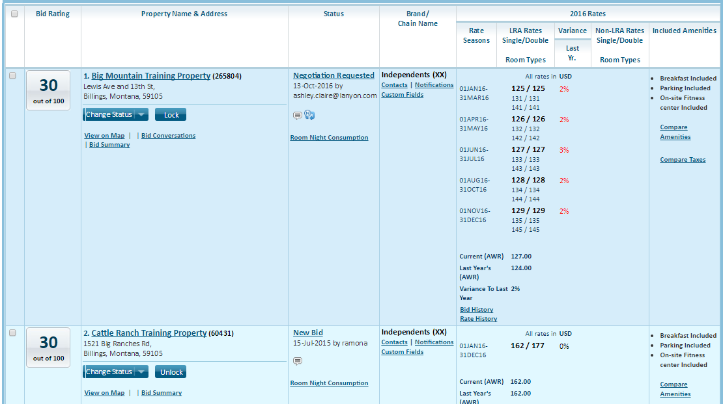
Review Bids from Hotels
Review Bids

Slide 13
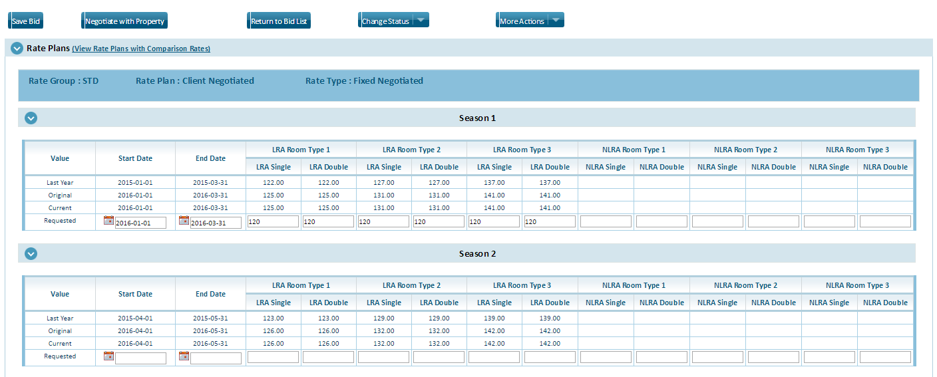
Negotiate Rates & Amenities
Negotiate & Accept

Slide 14
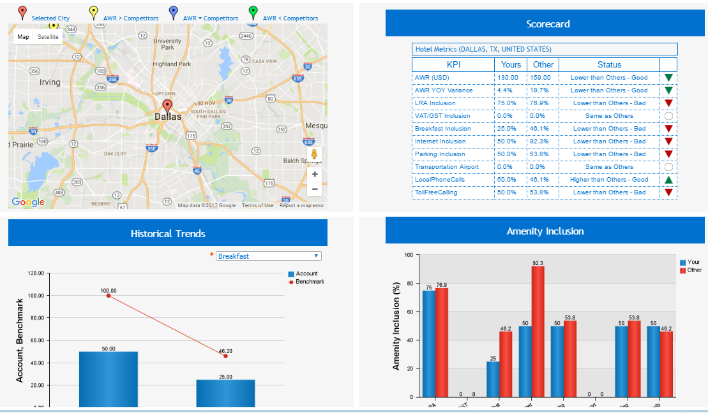
Benchmark

Slide 15
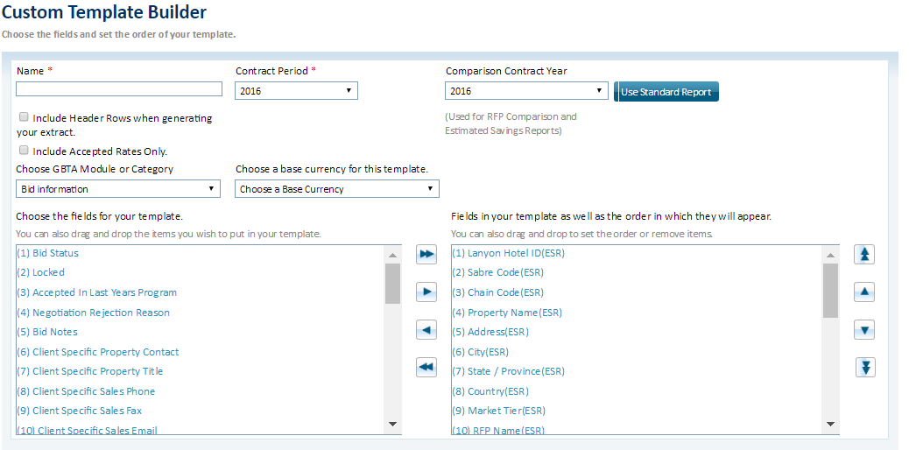
Standard & Custom Reporting
Reports

Slide 16
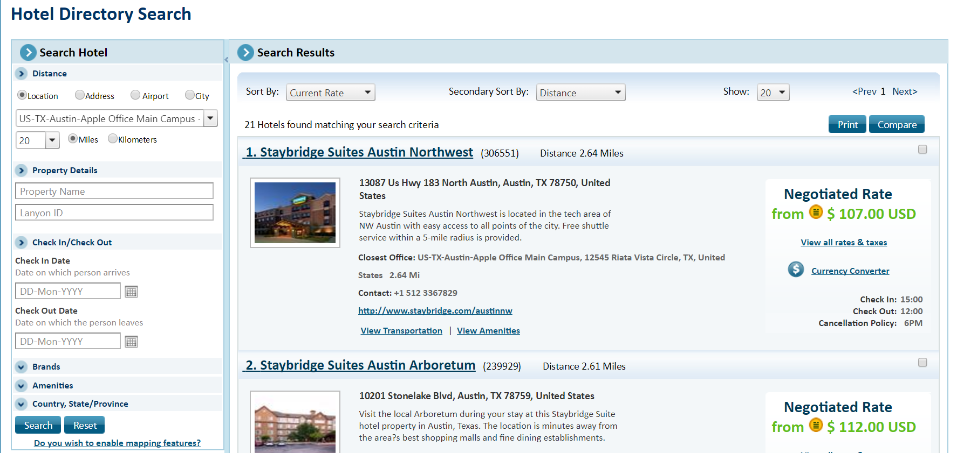
Hotel Directory

Slide 17
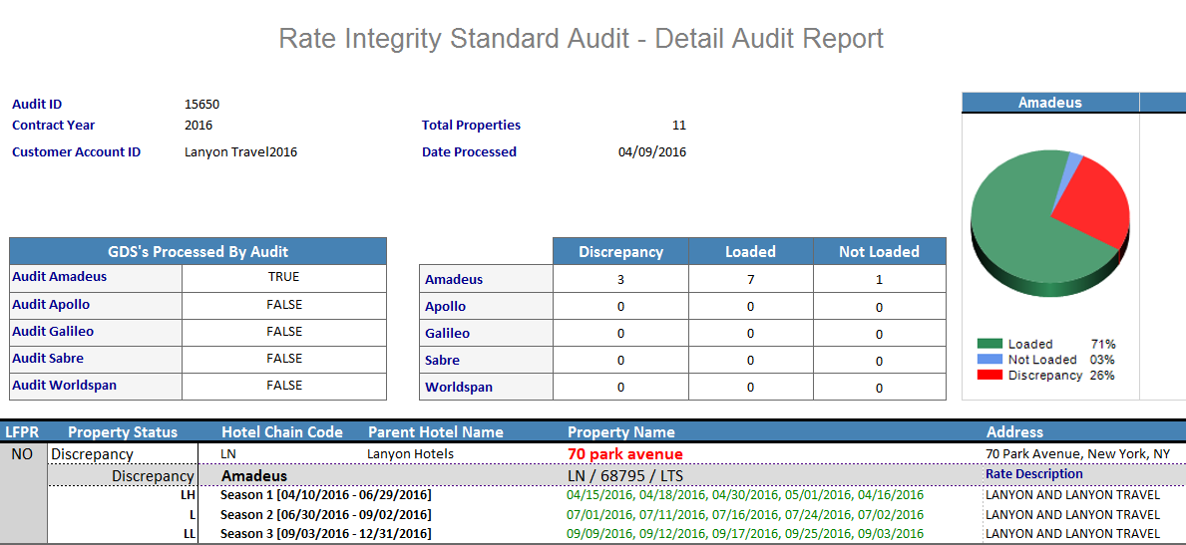
GDS Rate Audit
Reports

Slide 18
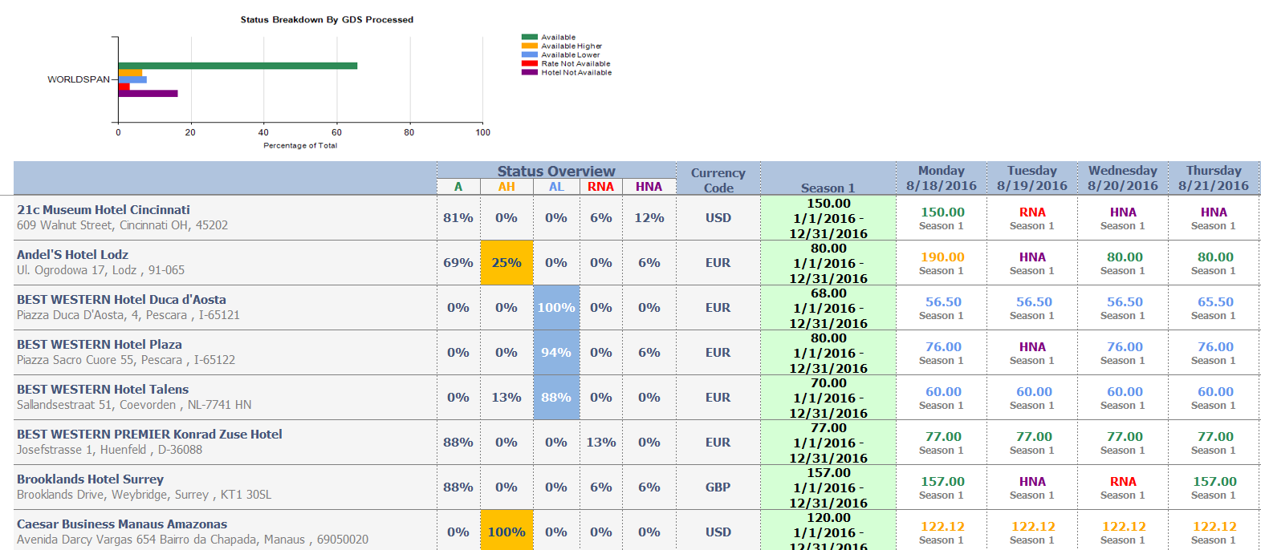
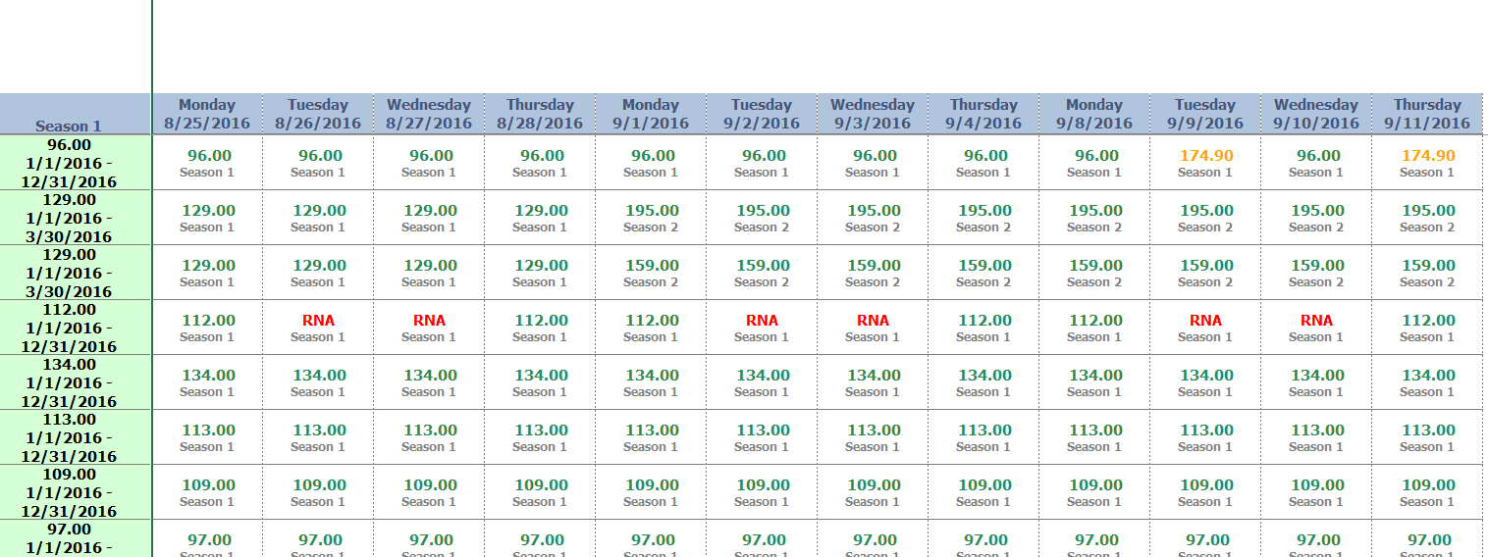
Rate Availability Reporting
Reports

Slide 19
Thank You! Questions?

Slide 20
For further information please contact: Jean Squires Senior Principal Account Manager jean.squires@cvent.com +44 (0) 7776 135124

