Slide 1
SAP Concur Available for you Now in Israel.
Alon Halperin, SAP October 08, 2018

Slide 2
The competing forces affecting corporate travel.
Travelers’ expectations are changing.
Regulatory requirements are tightening and evolving.
The travel industry is in flux.
Resources are increasingly scrutinized and strained.

Slide 3
It’s time to move beyond basic booking.
Booking Tool
Expense Report

Slide 4
All your travel. All in one place.
Booking Tool
Expense Report

Slide 5
Compliance
68%
of finance leaders aren’t completely confident that employees comply with company T&E policies

Slide 6
Duty of care
63%
of business travel managers
feel that risk to travellers
has increased
Ipsos, 2017

Slide 7
Traveler experience
43%
20%
want to add leisure to business trips
want the flexibility to explore business travel destinations
ACTE, 2017

Slide 8
Expenses
52%
of invoices are checked for duplication, errors and fraud

Slide 9
The Perfect Trip

Slide 10
The Perfect Trip: All In One Integrated Ecosystem
POLICY &
APPROVALS
BOOKING &
PAYMENTS
DUTY OF CARE &
COMPLIANCE

Slide 11
The Perfect Trip: All In One Integrated Ecosystem
Concur Request
TripLink
Smarter Travel Spend
Traveler Safety & Security
Full Regulatory & Policy Compliance
Maximum Productivity & Efficiency
Concur Locate
Online Booking Tool
POLICY &
APPROVALS
TripIt
BOOKING &
PAYMENTS
DUTY OF CARE ,
COMPLIANCE & TRAVELER PRODUCTIVITY

Slide 12
Let’s take a look at Sam, the business traveler.

Slide 13
Let’s take a look at our traveler, Sam’s, experience.
Organize all travel plans in one place.
Expense reports that write themselves.
Traveler
Get visibility into all reservations.
Locate your travelers.
Travel Manager
Access itineraries to support travelers.
TMC

Slide 14
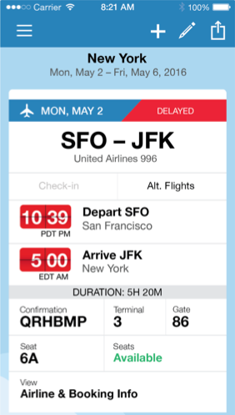
An effortless traveler experience.
Organize all travel plans in one place, accessible anytime, anywhere, on any device.
Get real-time flight alerts.
Easily find alternative flights.
Find better seats when they become available.

Slide 15
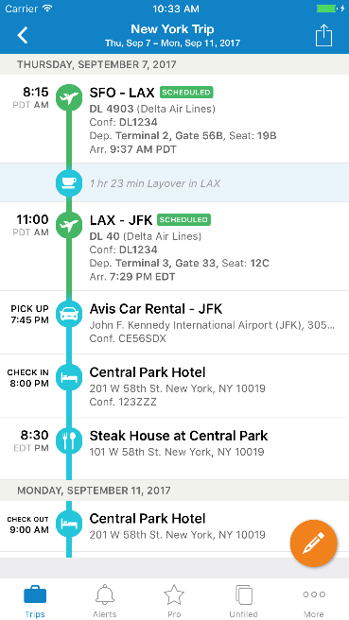
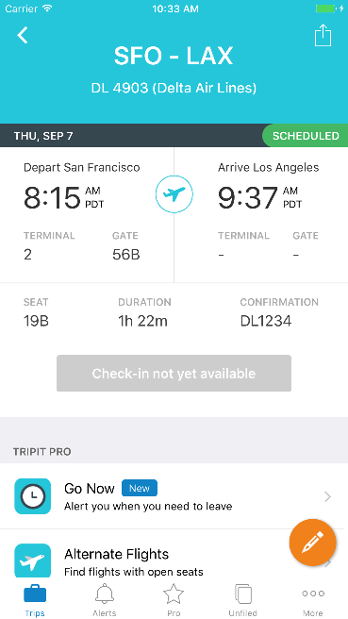
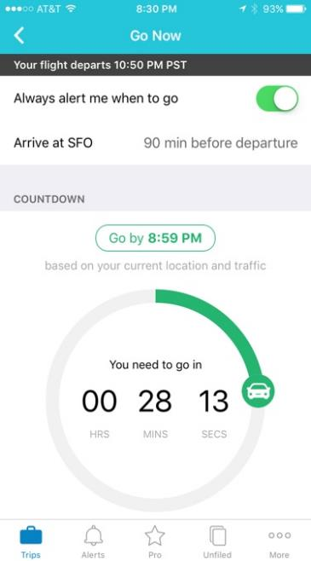
Mobile traveler experience
Delightful All-in-one view
Easy to Use
Productivity Tools
Actionable Alerts

Slide 16
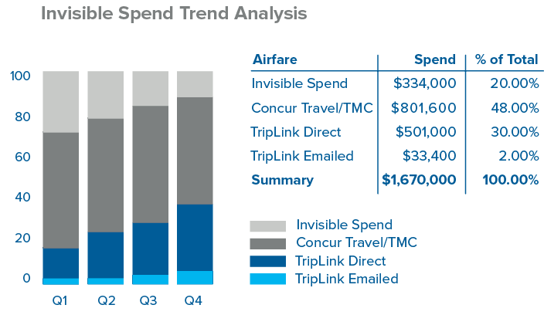
Complete travel management.
Track spending and buying behavior.
Apply and enforce policies.
Negotiate better deals.
Get negotiated rates on participating supplier sites.

Slide 17
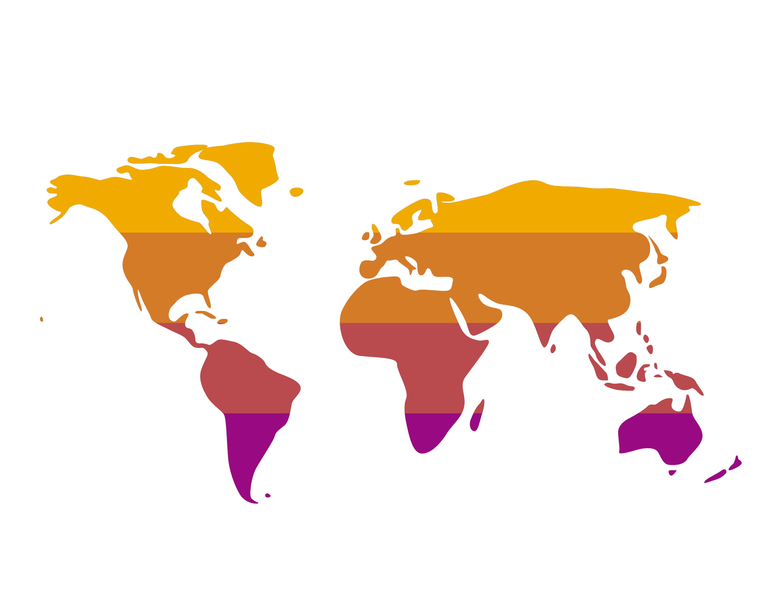
Help keep all your travelers safe.
Support your duty of care.
Empower TMCs to assist your travelers.

Slide 18
Thank You. Visit our booth & talk to us
Contact information:
Alon Halperin
Alon.Halperin@sap.com
052-3274766

