Slide 1
A short Video of Hospitality & Ground Transportation
https://youtu.be/KJBFNgTvFos
265ced1609a17cf1a5979880a2ad364653895ae8
Notes:
Please read these useful tips before you start using this template
Remove this slide when your PPT is ready

Slide 2



Your Window to Hospitality
and Beyond
NECSE Hospitality & Ground Transportation
March 2019
265ced1609a17cf1a5979880a2ad364653895ae8

Slide 3
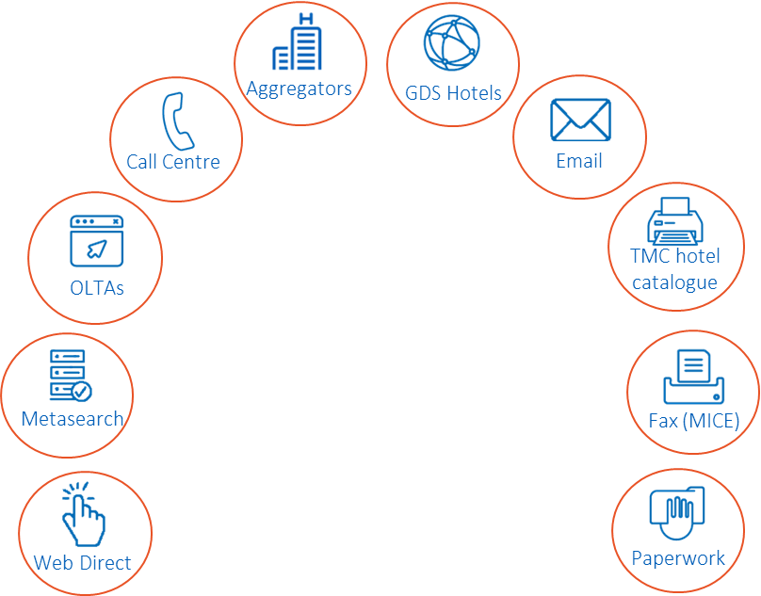



Challenges: Traveller
Time
There is too much choices
Value for money
Depending on the traveller type
Agility
Unexpected events
Expectation of personalisation
Personalization can drive relevance, convenience and value.
Notes:
Time
There is too much choice with so many distribution channels available today. Each traveller has different needs at different points. The only constant is that the traveller requires content which is relevant to them at the point at which they are travelling.
Value for money
Relevance is vital when understanding value for money. It’s different for everyone where expectations change depending on the traveller type as well as why they’re travelling and
who they’re travelling with.
Amadeus’ recent research has identified six future traveller tribes and the potential implication for
the hospitality industry.
Agility
Unexpected events, group bookings, tech to work anywhere and travellers wanting to combine business and leisure together in one trip, highlights the need for hoteliers and travel intermediaries to be able to meet the ever-changing needs of the traveller.
Expectation of personalisation
The challenge is not the ability to do personalisation in itself but what to do, when and how much. Personalisation can drive relevance, convenience and value. However, it’s important to understand how the traveller wants to engage with you (hotel or travel agent) at every touchpoint before doing anything at all.

Slide 4
Our mission is to make things simple,
for our travellers experience.
We Deliver
clear value
Our strategy is focused and progressive
Notes:
We have partnered with an extensive range of hotel suppliers to cater to the needs of all hotel bookers across sales channels, whether corporate, leisure or a mixture of both.

Slide 5
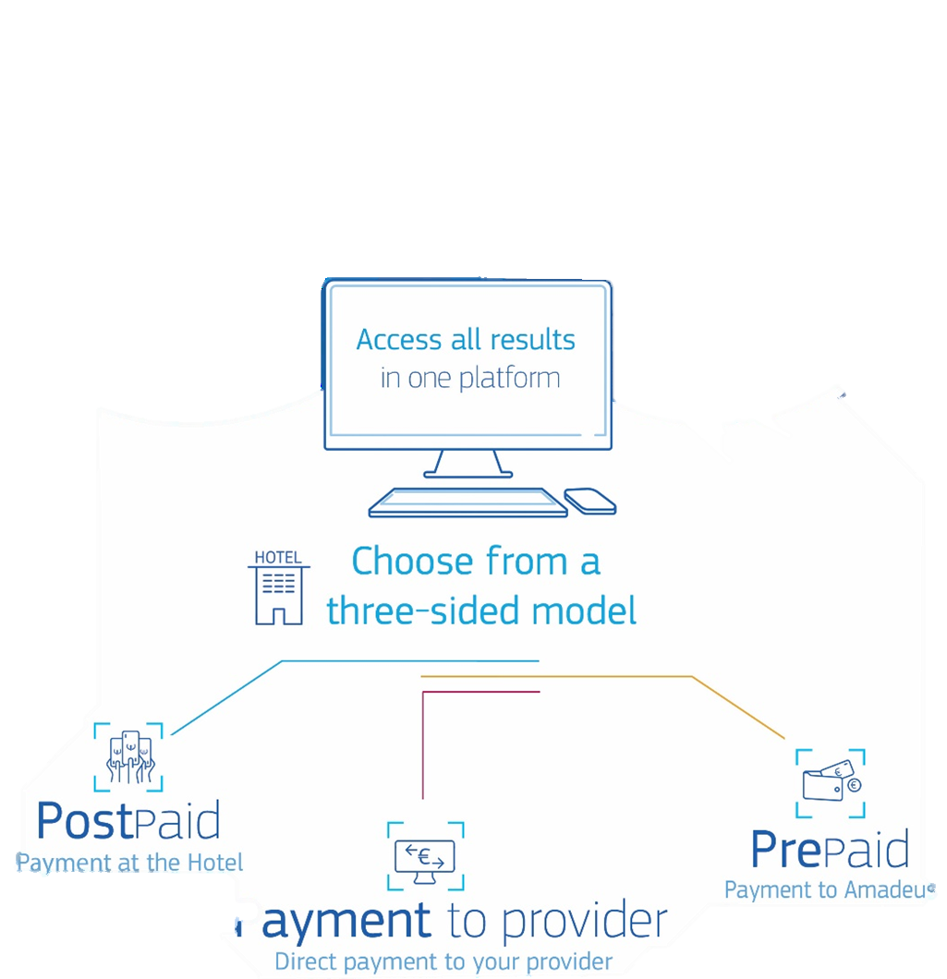
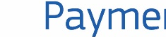
Notes:
Amadeus Value Hotels
Net rate hotel content with Amadeus acting as 'merchant of record'. Amadeus sources competitive net rates which travel agencies can then mark up for onward sale. Perfect for smaller leisure agents who don't have buying power to negotiate rates independently.

Slide 6
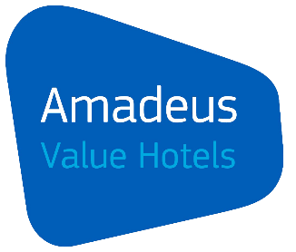
Our Value proposition in a nutshell
2.5+ million hotel shopping options. 618K unique properties.
Amadeus Value Hotels
.
Notes:
Amadeus Value Hotels
Net rate hotel content with Amadeus acting as 'merchant of record'. Amadeus sources competitive net rates which travel agencies can then mark up for onward sale. Perfect for smaller leisure agents who don't have buying power to negotiate rates independently.

Slide 7













Our Value proposition in a nutshell
2.5+ million hotel shopping options. 618K unique properties.
Amadeus Value Hotels
.
310 top hotel chains
Figures as of Q1 2018
Notes:
310 top hotel chains
310+ top Hotel chains & Rep. companies offer of 3 & 4 star business hotels, budget chains, extended stay properties, leisure/resort hotels, luxury hotels, boutique hotels, B&Bs & serviced apartments.

Slide 8













Our Value proposition in a nutshell
2.5+ million hotel shopping options. 618K unique properties.
Amadeus Value Hotels
.
310 top hotel chains
Regional &
global aggregators
Figures as of Q1 2018
Notes:
Regional & global aggregators
Established regional and global aggregators can now be booked directly through Amadeus.

Slide 9






Our Value proposition in a nutshell
2.5+ million hotel shopping options. 618K unique properties.
Amadeus Value Hotels
.
310 top hotel chains
Regional &
global aggregators
Independent hotels
& small groups
Figures as of Q1 2018
Notes:
Independent hotels & small groups
Amadeus LinkHotel, our own representation company, sources 3,000+ independent hotels and small groups from around the world.

Slide 10
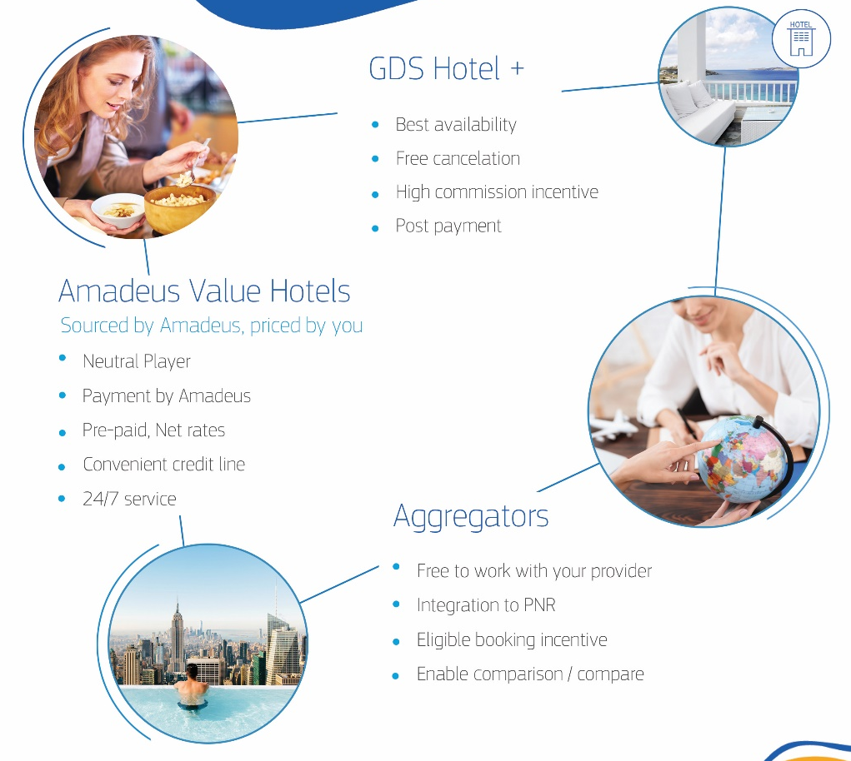
Notes:
Amadeus Value Hotels
Net rate hotel content with Amadeus acting as 'merchant of record'. Amadeus sources competitive net rates which travel agencies can then mark up for onward sale. Perfect for smaller leisure agents who don't have buying power to negotiate rates independently.

Slide 11
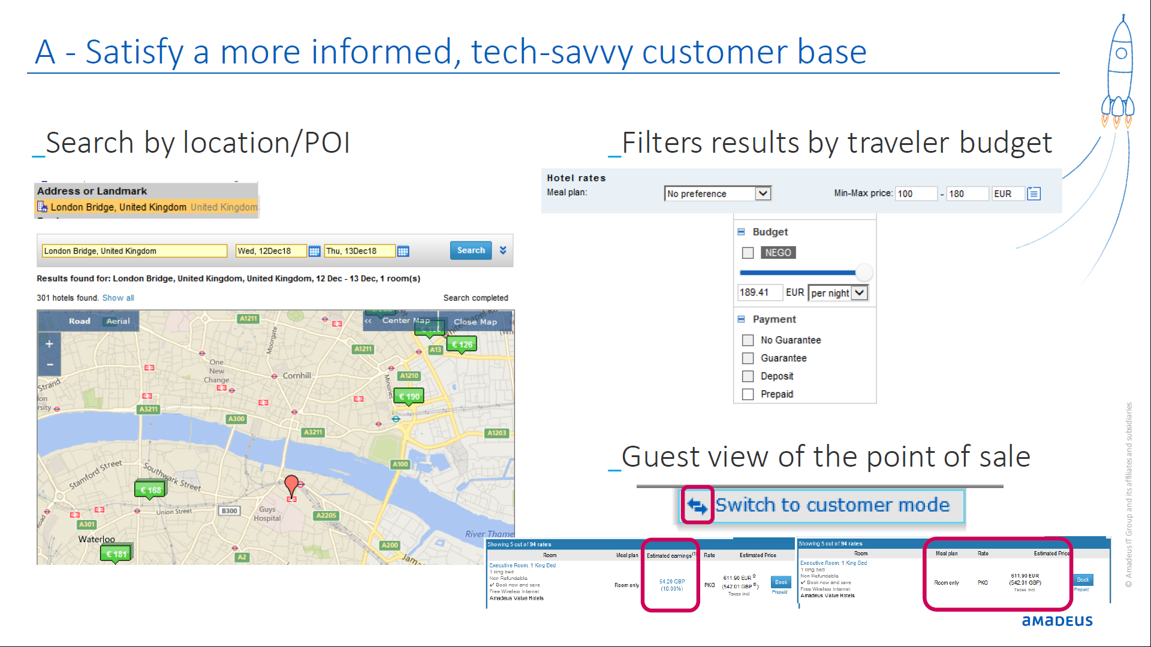
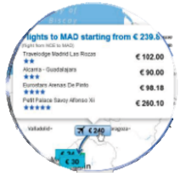
Graphical User Interface
Smart interface suits all types of users
Intuitive booking flow
Single screen display with all information is at hand
Intuitive interface: book from the map, easy.
Minimal training needed

Slide 12
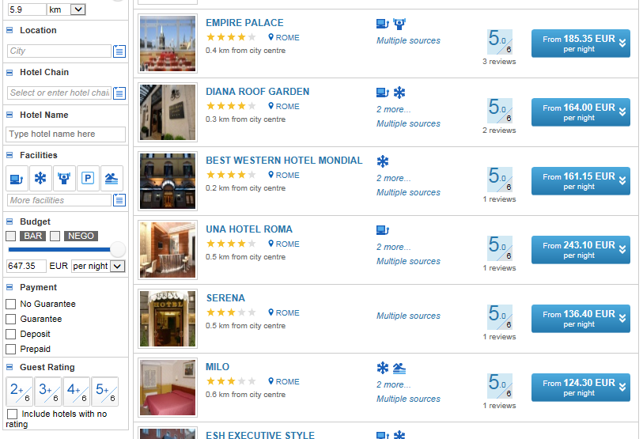
Detailed
search & filter
criteria help you
find the perfect
hotel for your customers
Detailed
search & filter
criteria help you
find the perfect
hotel for your customers
Data is easy to find, understand, bookmark, compare, save and forward
More relevant content integrated for greater efficiency
Targeted searching and navigation

Slide 13
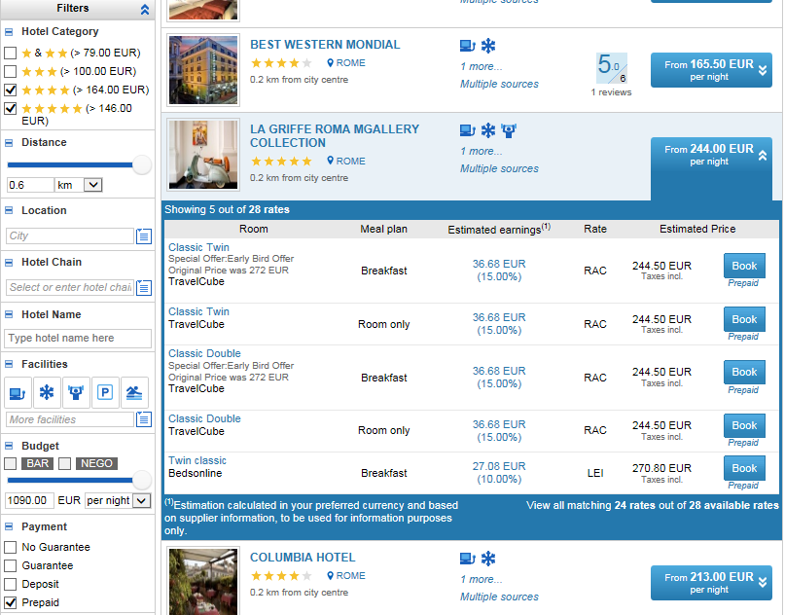
Identify at a
glance the
best revenue opportunity for your business

Slide 14
Choose and
compare the
most suitable
paying option

Slide 15
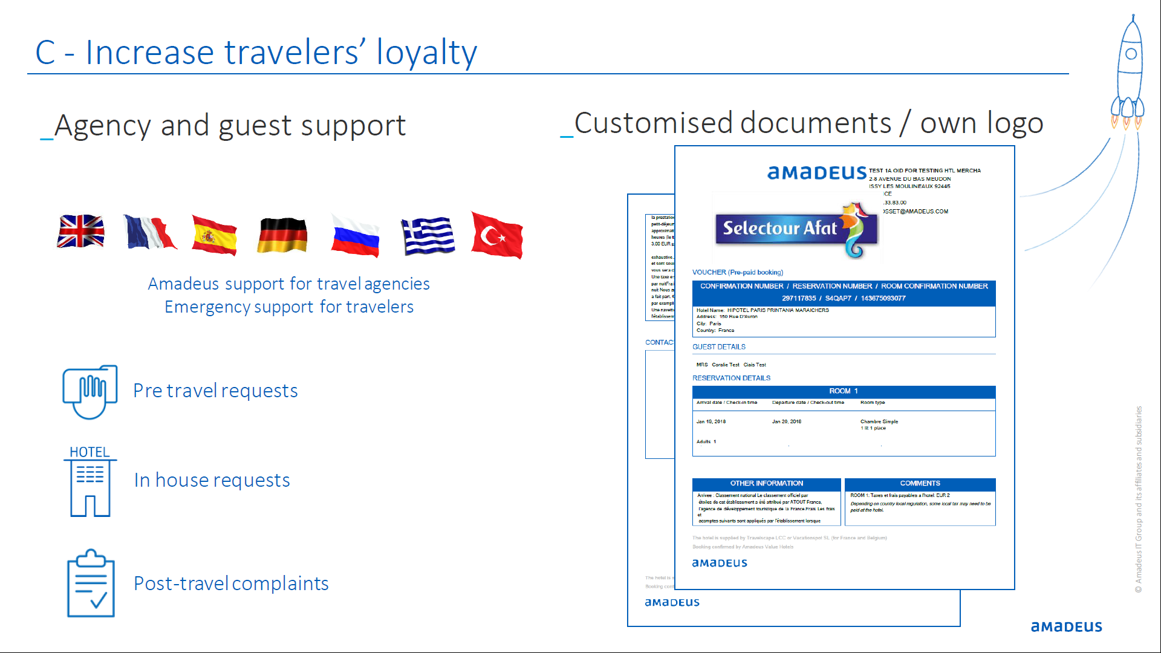
Always connected and updated

Slide 16
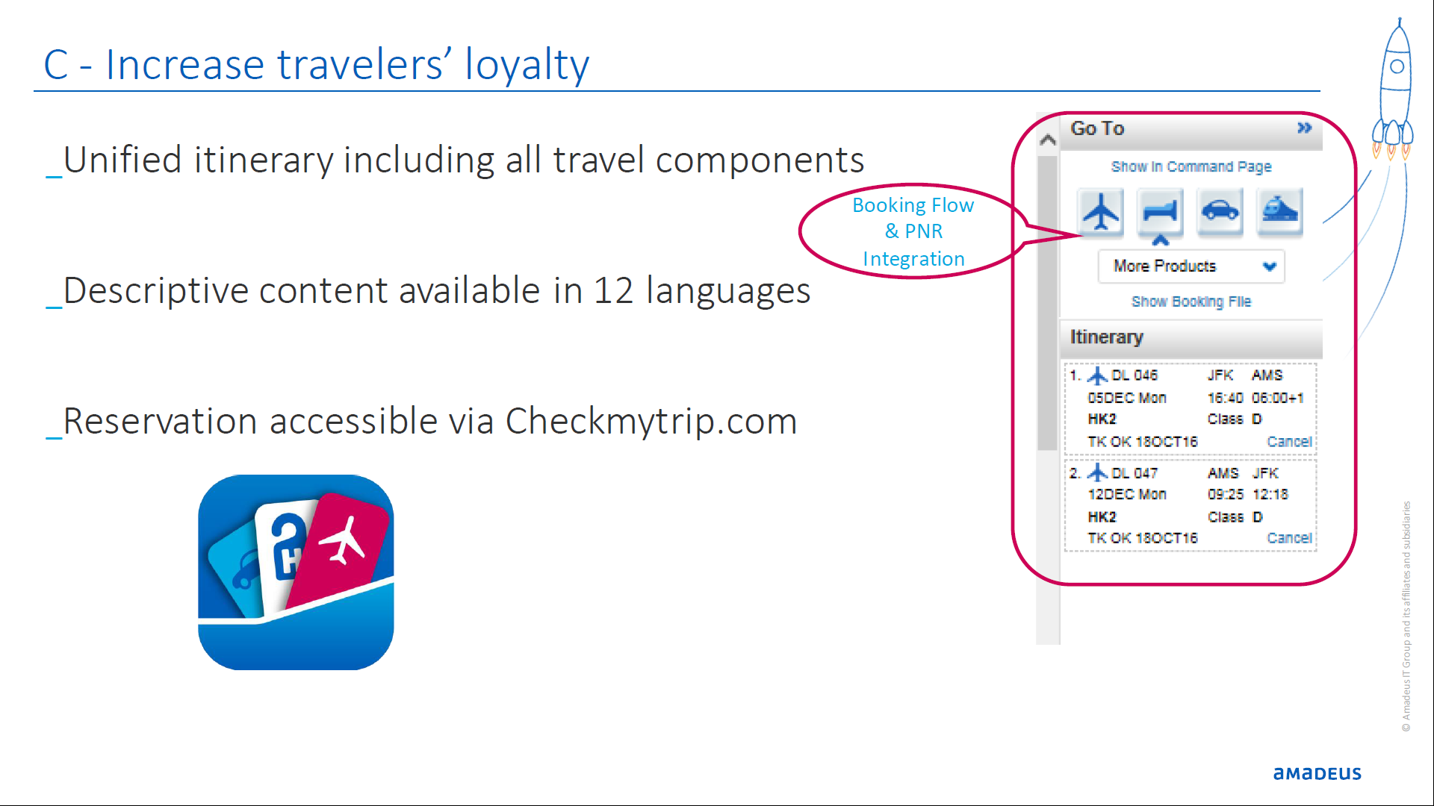
One Stop Shop

Slide 17


A short summary
what’s in it for your corporate
You can simplified
your work and reduce workload
and higher efficiency,
Working with corporate polices
to minimise the cost
By using Amadeus you will become
to preferred coordinator
Nothing will miss your eyes with Amadeus solutions.

Slide 18
Thank you
amadeus.com
amadeus.com/blog
You can follow us on:
AmadeusITgroup
265ced1609a17cf1a5979880a2ad364653895ae8
Notes:
Backcover option 2

