Slide 1
The only travel platform you’ll ever need
Amsalem Tours & Travel Ltd.

Slide 2

USA online adoption

Slide 3
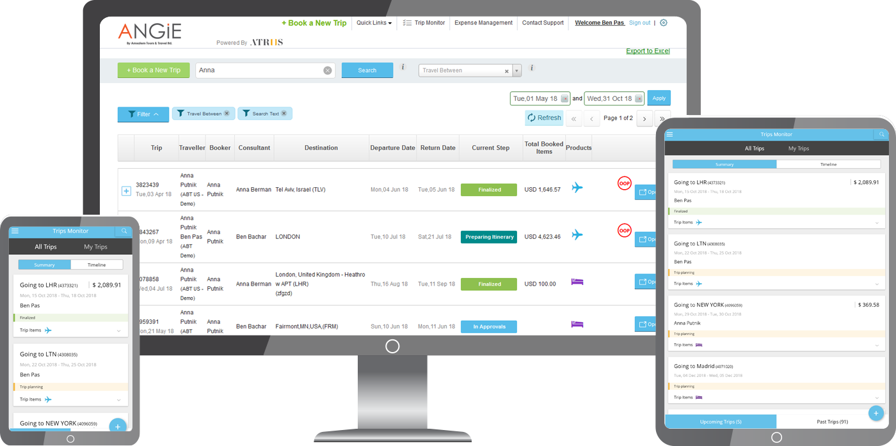




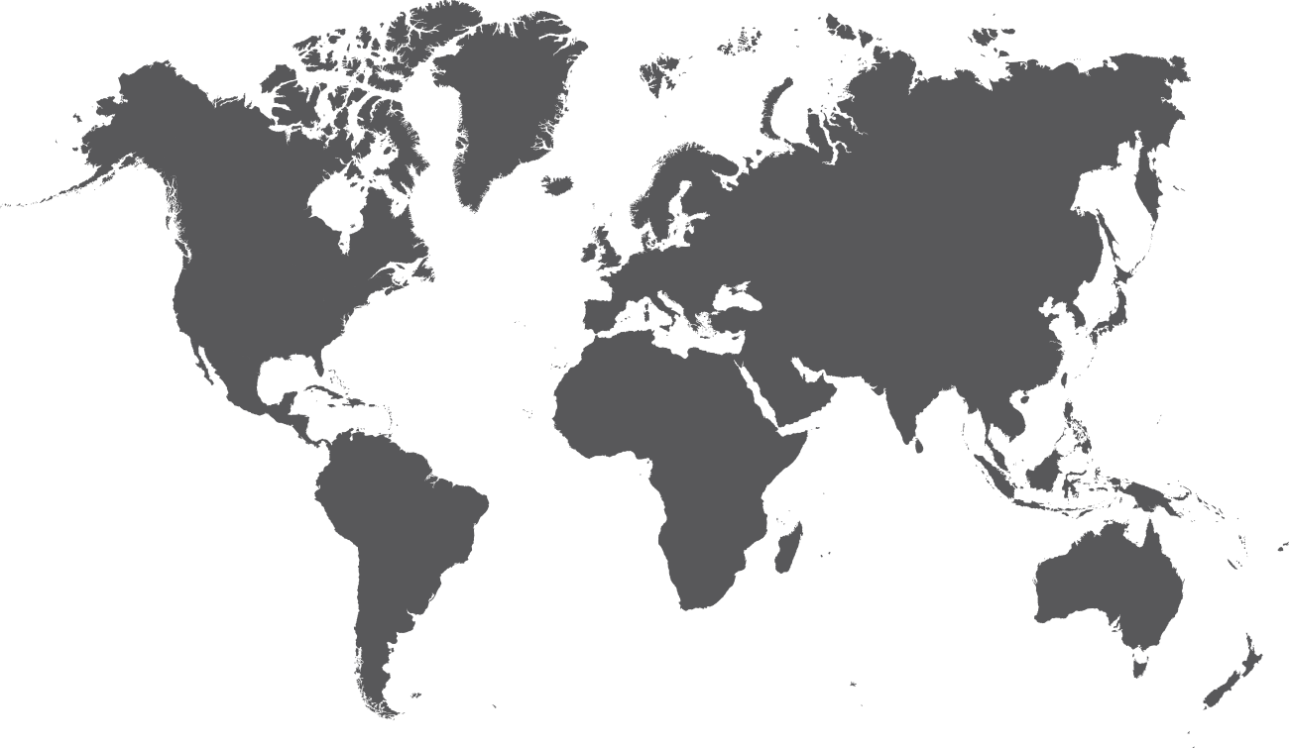
Angie, in short
Angie, powered by Atriis Technologies Ltd., is a next-generation Software as a
Service (SAAS) travel management platform that combines multi GDS’s, NDC and essentially most available travel content into one screen
NDC
TMC/Agents
GDS
Travel Manager
Marketplace
Travelers
Global Shared Services

Slide 4



The people & technology behind Angie
Angie is the brainchild of the Amsalem Tours & Travel Ltd.
a leader in global corporate travel management solutions
for over
35
8 offices
around the globe
and a dedicated
R&D Atriis Technologies Ltd. in Israel
years

Slide 5














Angie is being used by the best

Slide 6
Unbeatable content

Slide 7



































All travel products from all sources, in one-single screen
Offering friction less model with Amsalem:
Full prices Transparency (UATP & Air Plus) + agreed handling fee
Roadmap

Slide 8

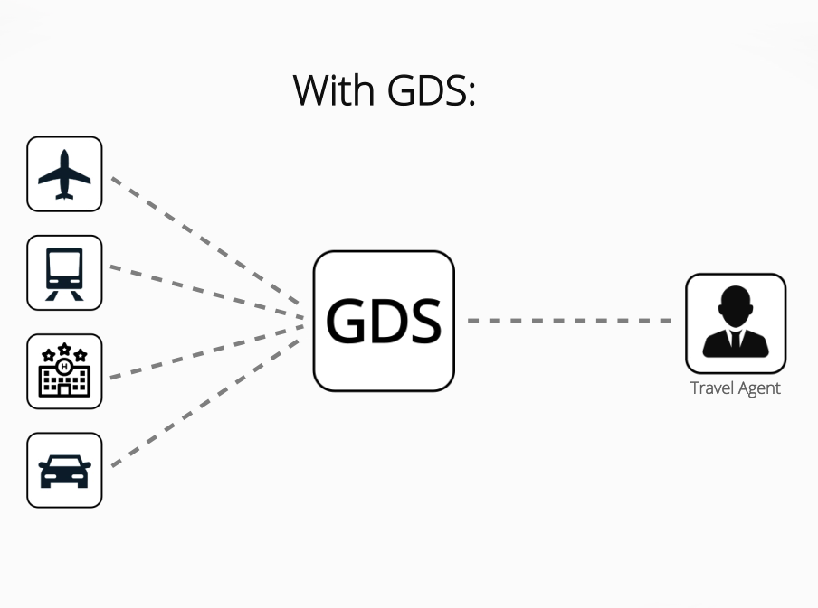

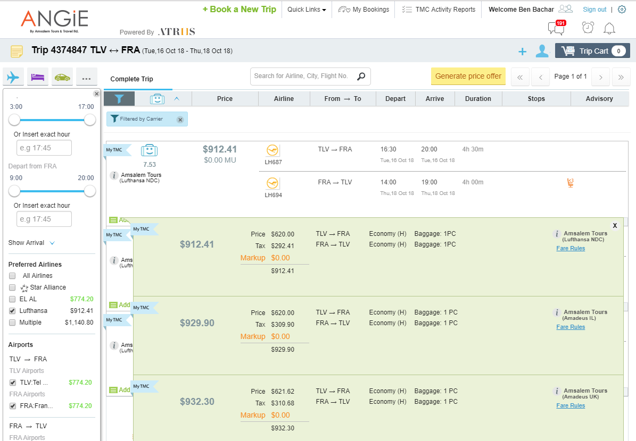
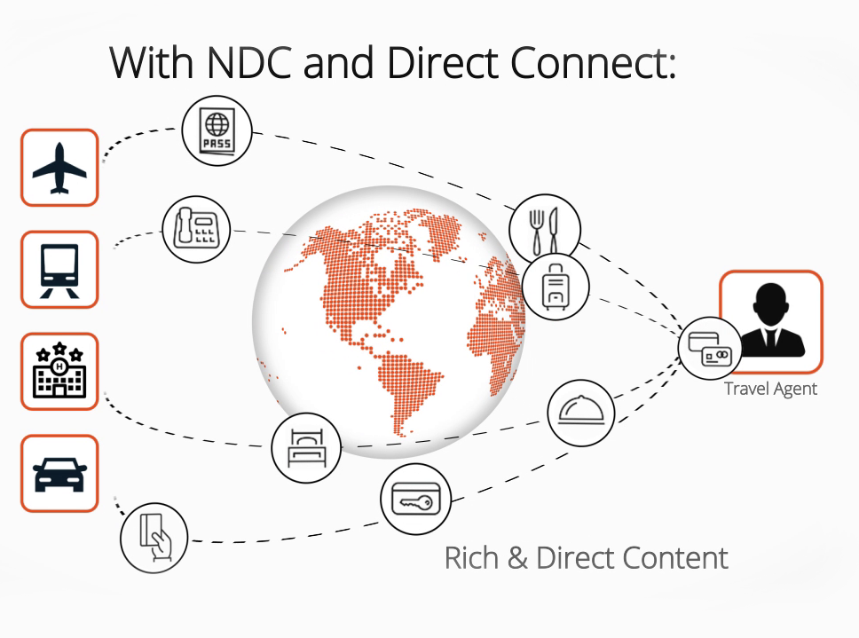
Fully integrated NDC
Direct pricing from vendors that support NDC technology:
LH Group, BA, AA. under development: AF/KL, AC, UA, QX …

Slide 9



The added value of NDC
DTC
Avoid distribution technology charges:
Exclusive fares on NDC:
NDC exclusive ancillaries
save an additional
WiFi, lounge access…
$20-$30 on average
$40-$90, on coach
& up to $500 on Business
compared to GDS fares
Reduced fares for ancillaries
Special timely airline promotions
seating, baggage...
only on NDC

Slide 10
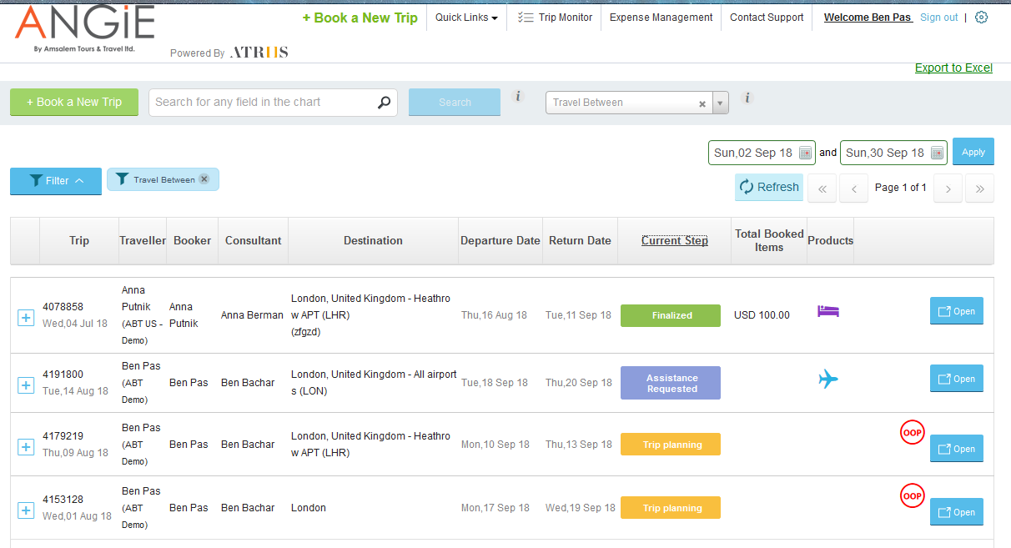

Fully global
Global Shared Services
One global platform: work with your chosen TMCs, anywhere in the world
A True Global System
Use One site, One log in to view & manage your corporate global travel program

Slide 11

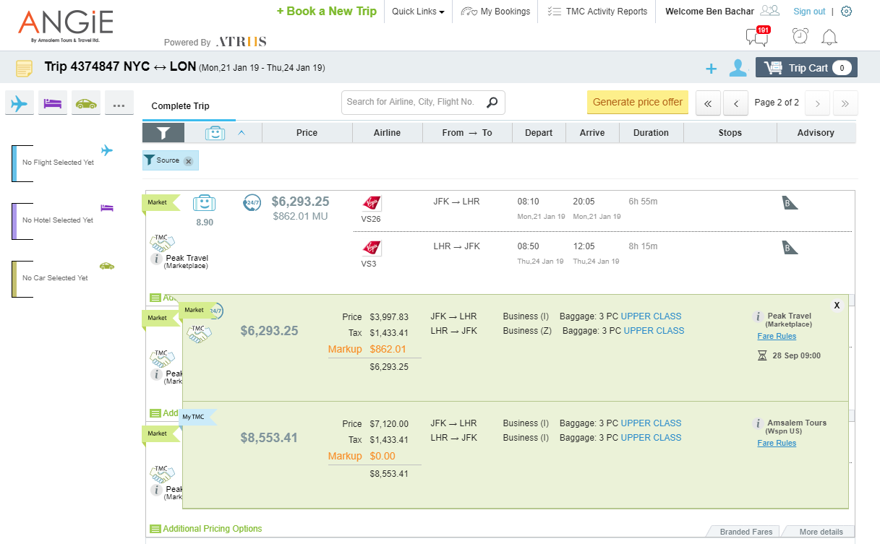
Integrated TMC Marketplace
A B2B global trading arena for TMCs, delivering exclusive point of sales best prices

Slide 12
Key features

Slide 13
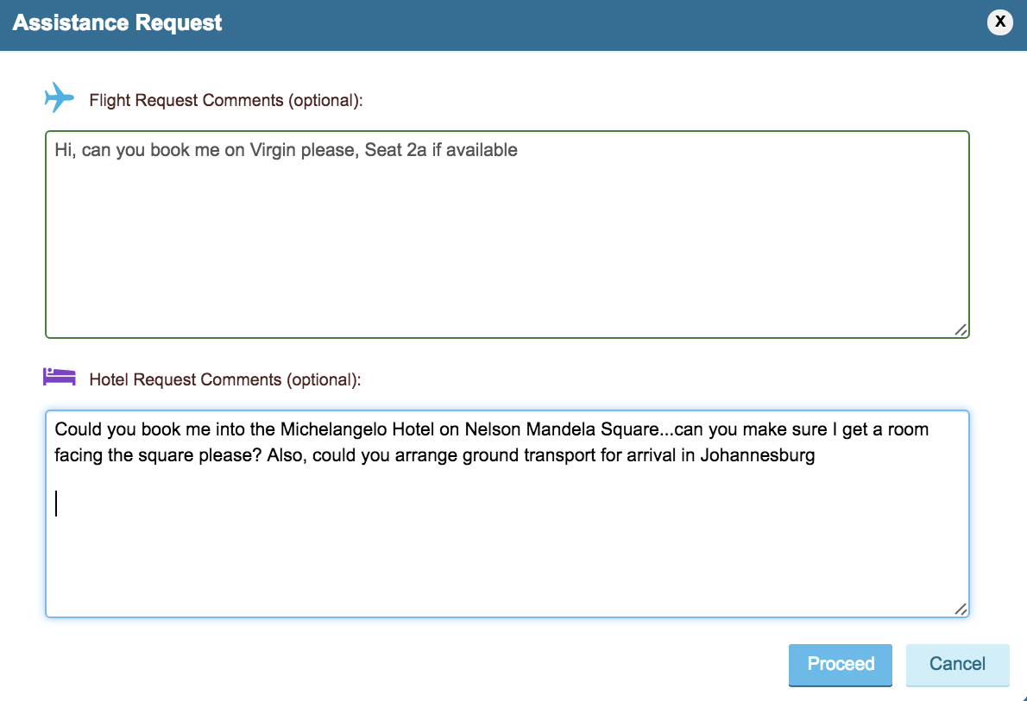
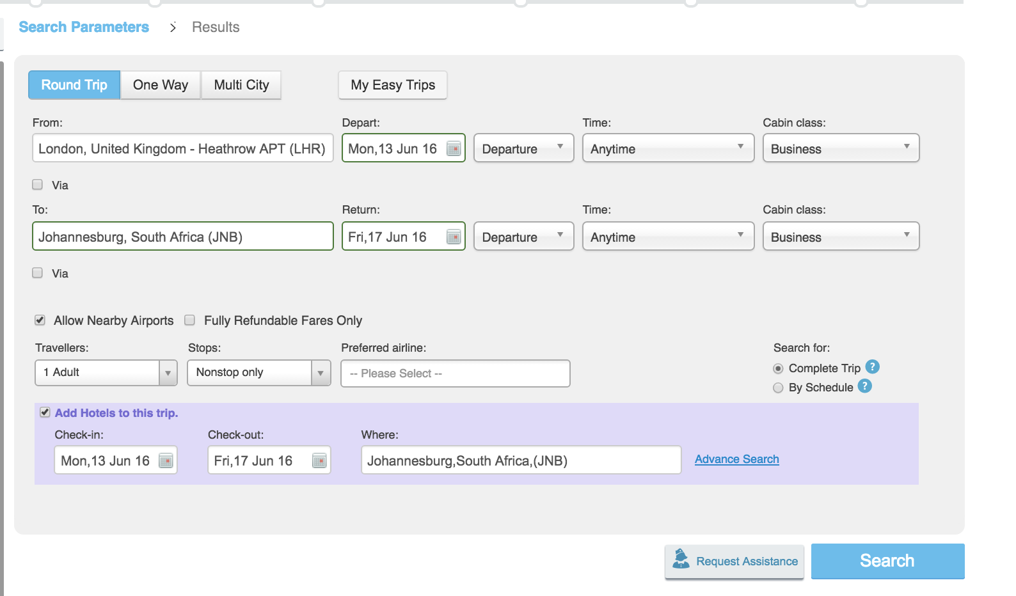
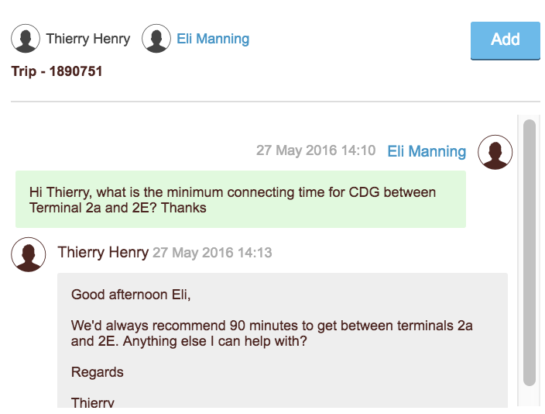
Agent assisted mode
Work on your own - or let an agent do the work
Hi, can you book me on Virgin please, Seat 2a if available
Could you book me into the Michelangelo Hotel on Nelson Mandela Square… Can you make sure I get a room facing the square please? Also, could you arrange ground transport for arrival in Johannesburg

Slide 14
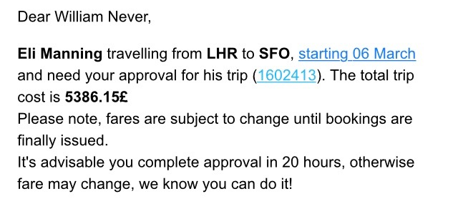
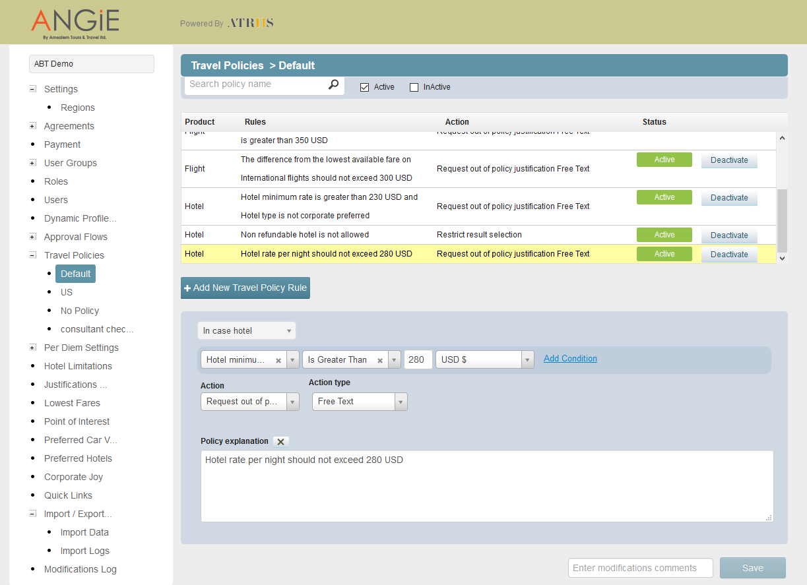
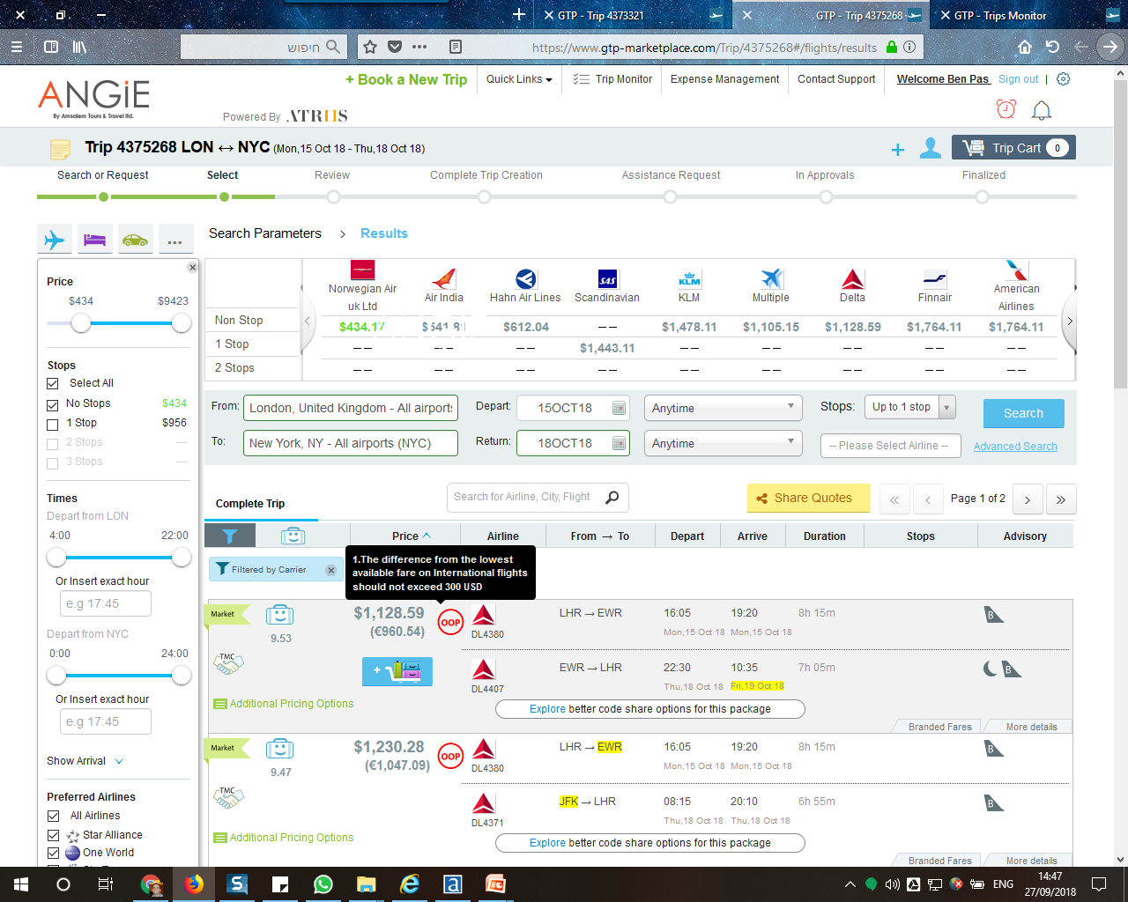
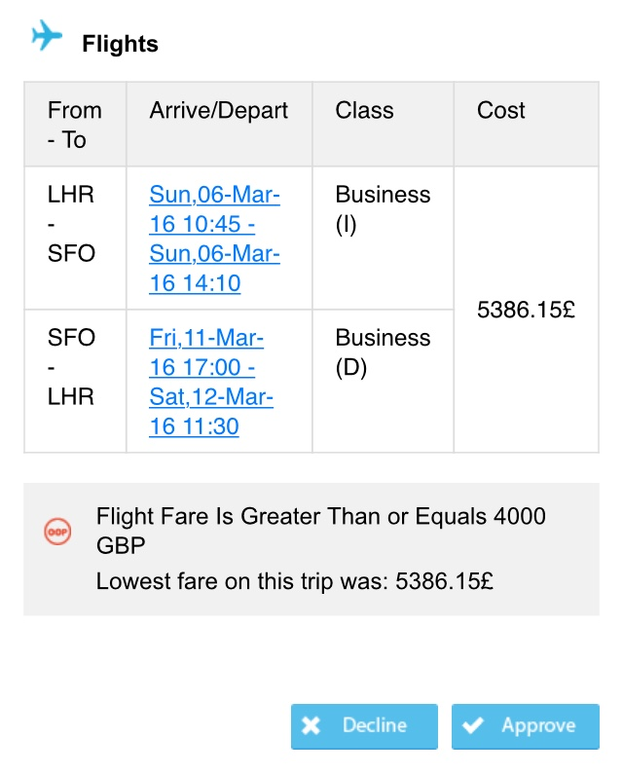
Robust travel policy and approval flow engines
Configure your policy and approval flow
3
1
2

Slide 15
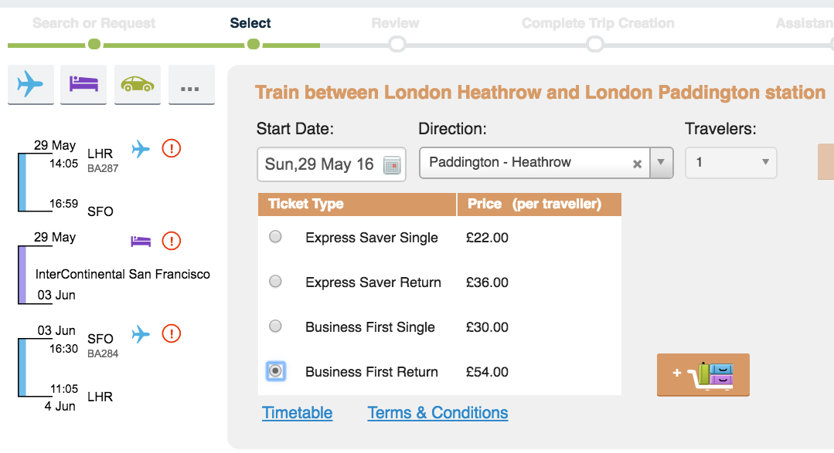
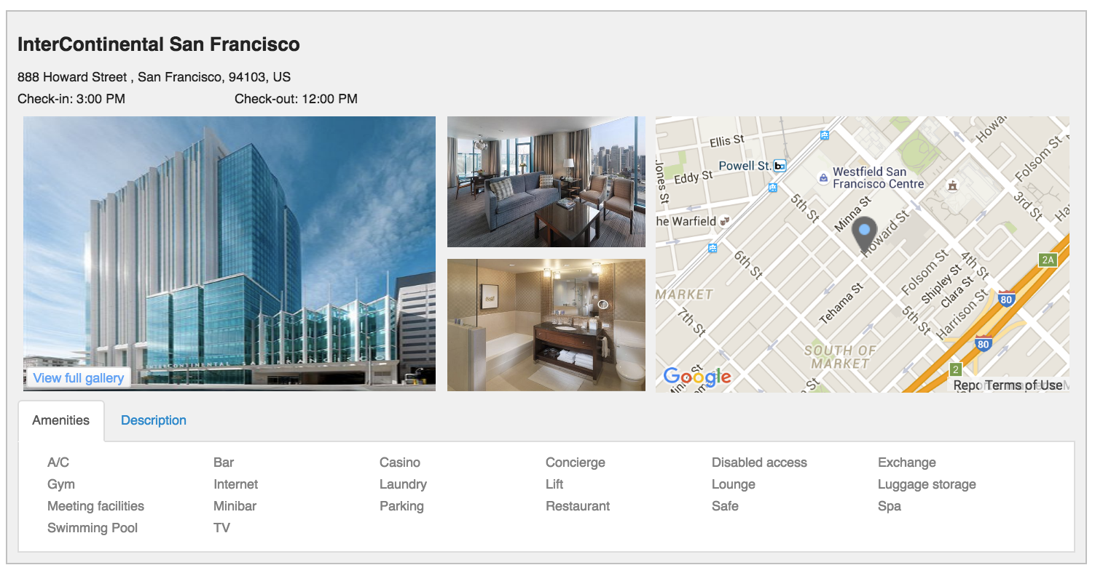
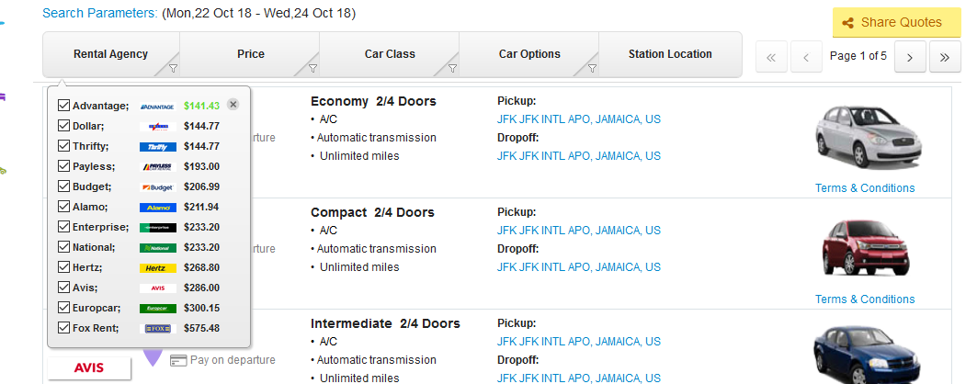
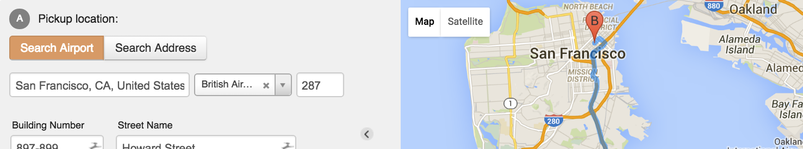
User experience just like consumer sites
Work like you’re used to

Slide 16










Fully integrable with other systems
EXPENSE MANAGEMENT
PROFILE SYSTEMS
DUTY OF CARE & RISK MANAGEMENT
Automated Safety Intelligence

Slide 17

Comprehensive reporting integration

Slide 18
The bottom line

Slide 19


The only travel system you’ll ever need
ANGIE is Digitalizing
the Managed Travel World
The most cost effective, tailored travel itinerary at a click of a mouse
All content and travel opportunities in one screen, on any device
Full NDC
integration
Full corporate compliance and integration
Full collaboration - TMCs, Clients and Travelers work on the same
easy-to-use platform

Slide 20
What are the benefits to you?
Enhanced business visibility & control
Effective & easy to use
Cost optimization
Connectivity
Sharing

Slide 21
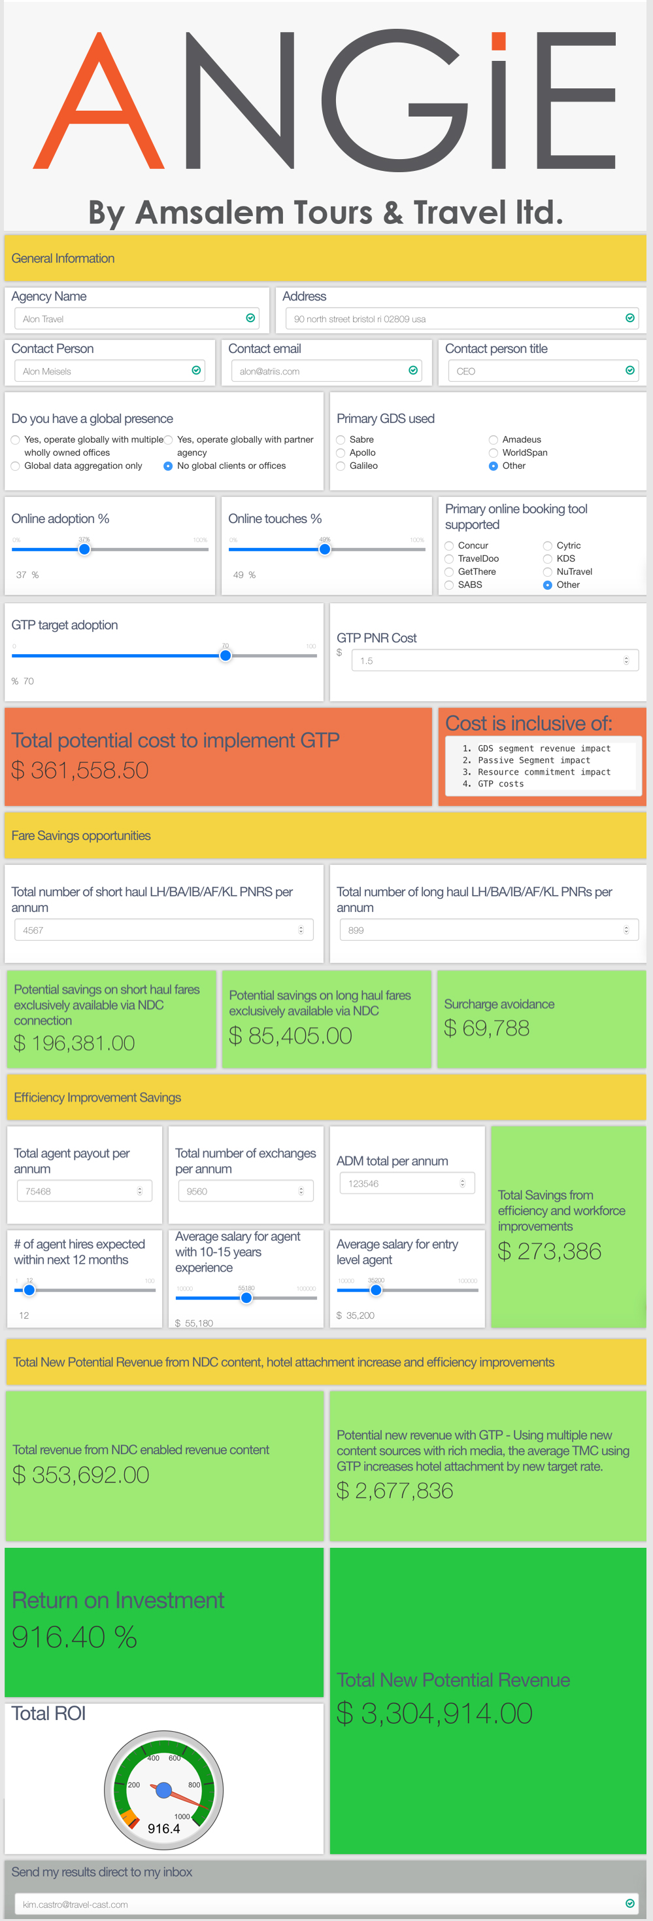
ANGIE corporate saving calculator

Slide 22




More to come soon: Angie’s roadmap
Real-time, automated
trip disruption solutions
Dynamic Travel policies based on machine learning capabilities
Flight requests through an AI-based chatbot
New UI for even
better experience

Slide 23
What our customers are saying
“…highly innovative and intuitive …best in class travel policy management and outstanding trip management”
Simon Ferguson, Managing Director, UK Ireland & Nordics, Travelport
“A genuine game changer”
Business Travel Award
“I saw the future yesterday and it’s happening now!”
Herve Puault, Director Account Management, Travel Leaders Group, USA

Slide 24
Thank you

Slide 25
Our next workshop…
Register now:
www.amsalem.com/ndc

